Slide 1




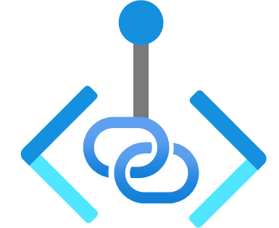




Virtual Network
Delegated Subnet
Default Subnet
GatewaySubnet
Injected Container
Private Endpoints
Dataverse Plug-in
Dataverse Plug-in
SQL Connector
On-premises
SQL Connector
Virtual Network Peering
Azure resources
Virtual Network Peering
Spoke Virtual Network
RISE with SAP

